Slide 1
✍Mastering (oop) using c++
✍Lecture_1 :
Intro to oop
Encapsulation
Inheritance
Polymorphism
Complex class example
✍Lab_1

Slide 2
✍Mastering (oop) using c++
✍Lecture 2 :
Default Arguments
Polymorphism (overloading functions )
Constructor & Destructor
This pointer
Stack example
Static members
Lab2 .

Slide 3
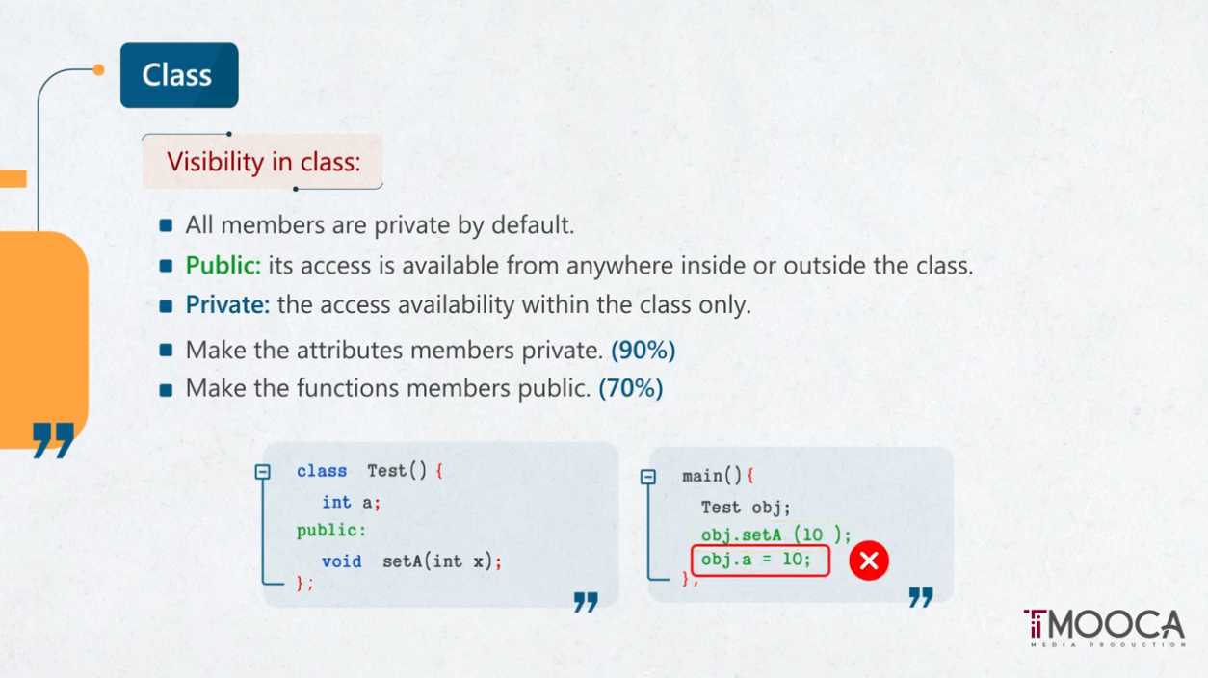

Slide 4
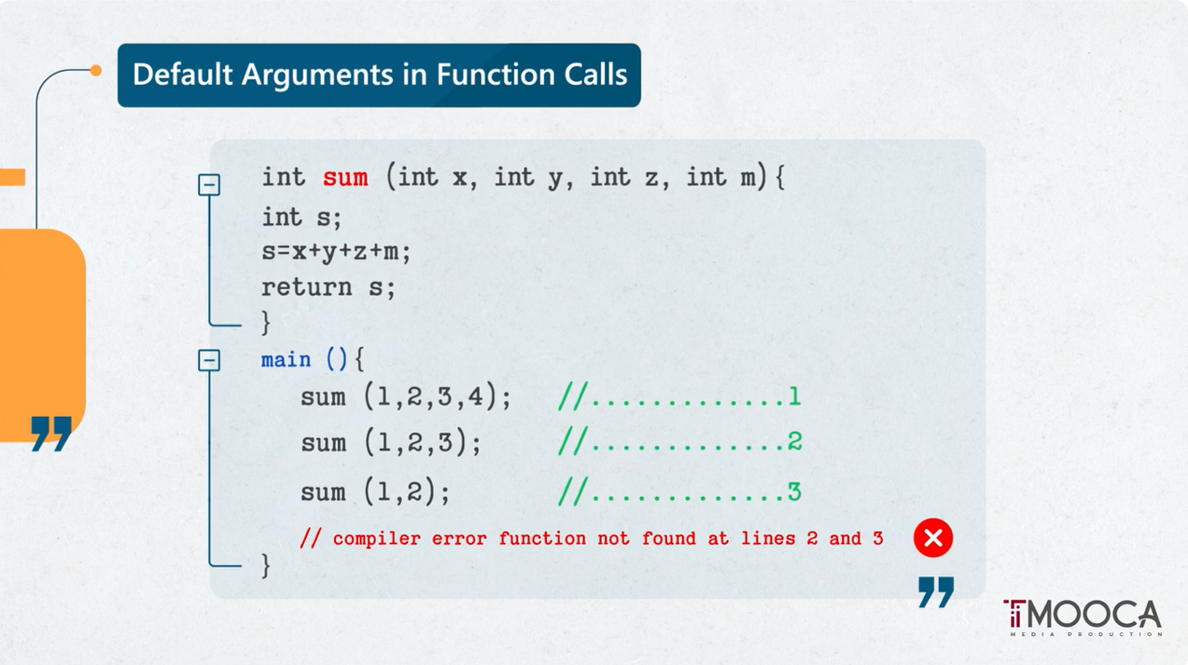

Slide 5


Slide 6
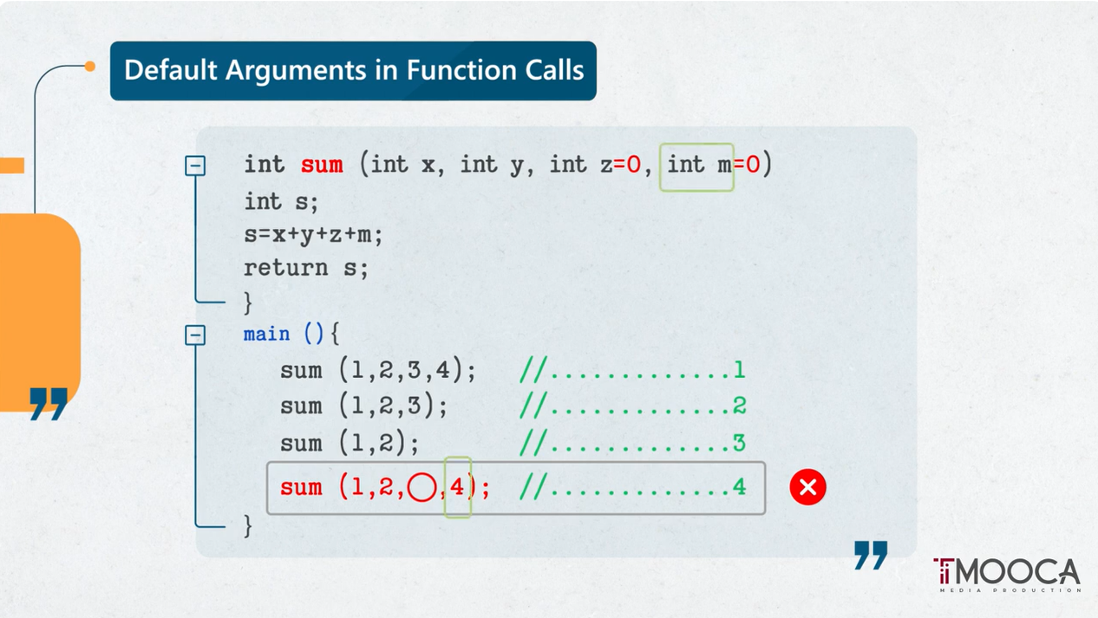

Slide 7
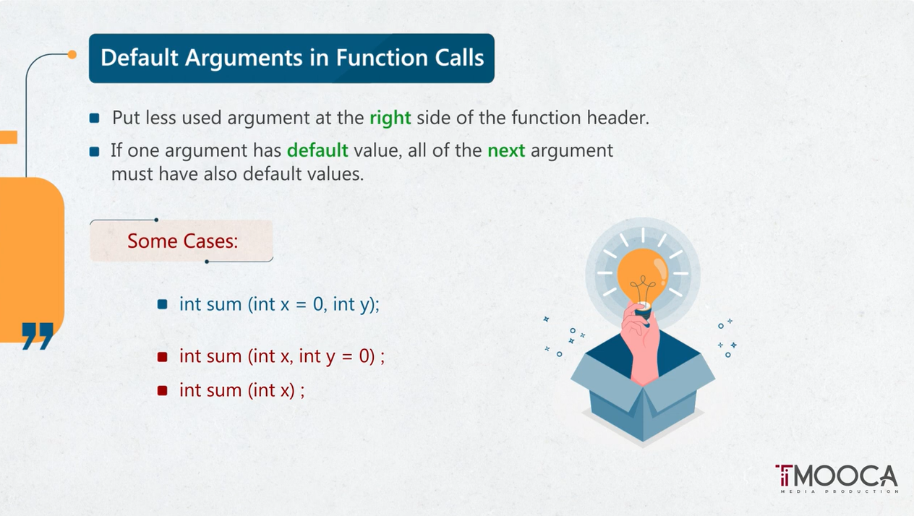

Slide 8
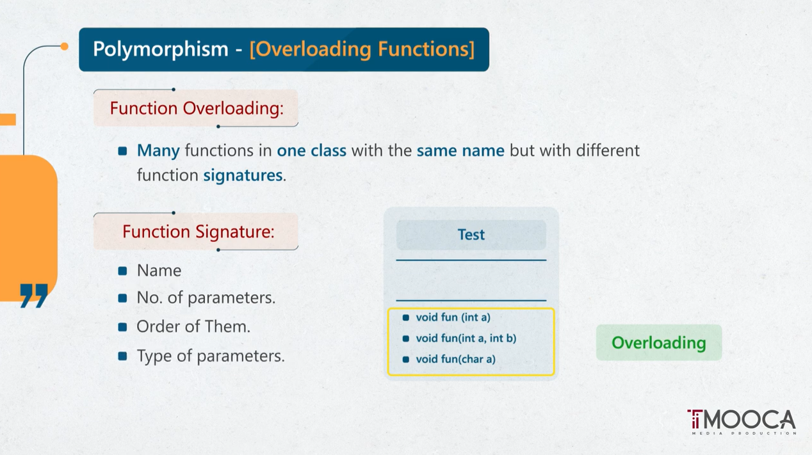

Slide 9
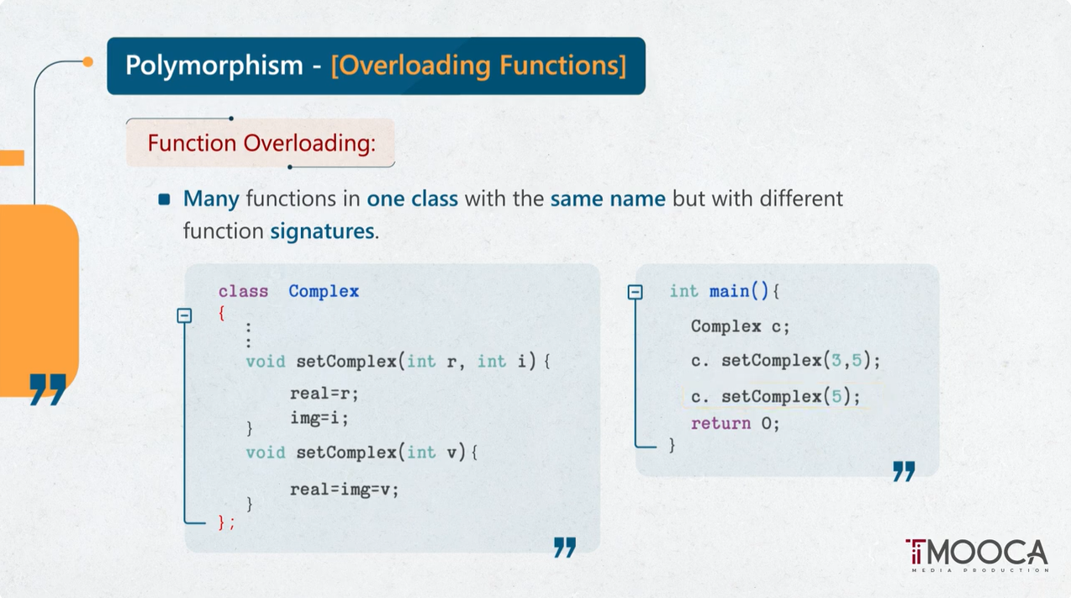

Slide 10
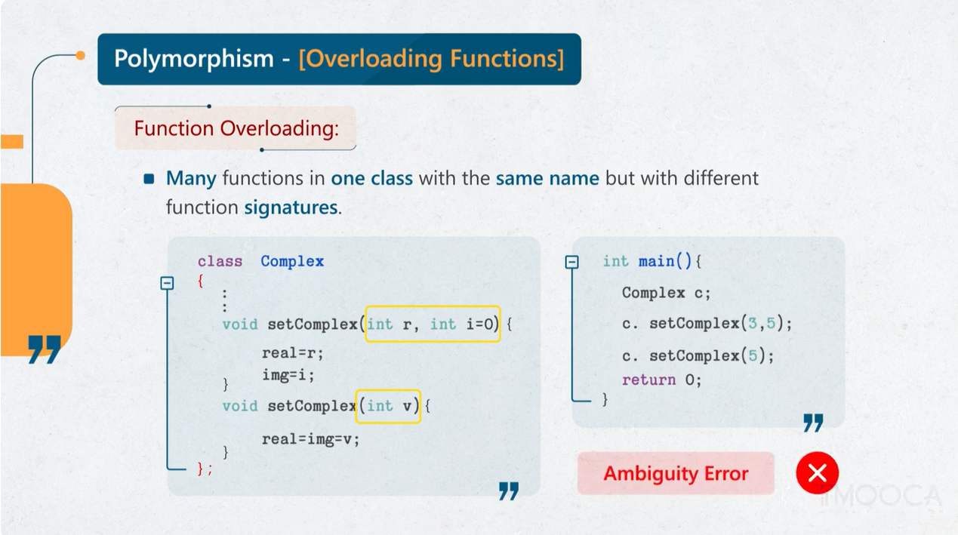

Slide 11
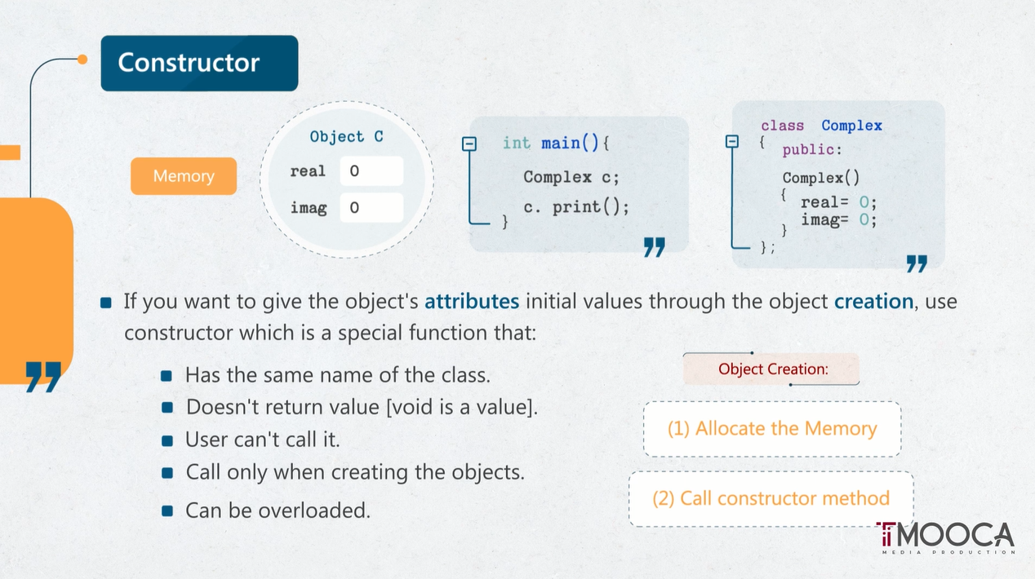

Slide 12
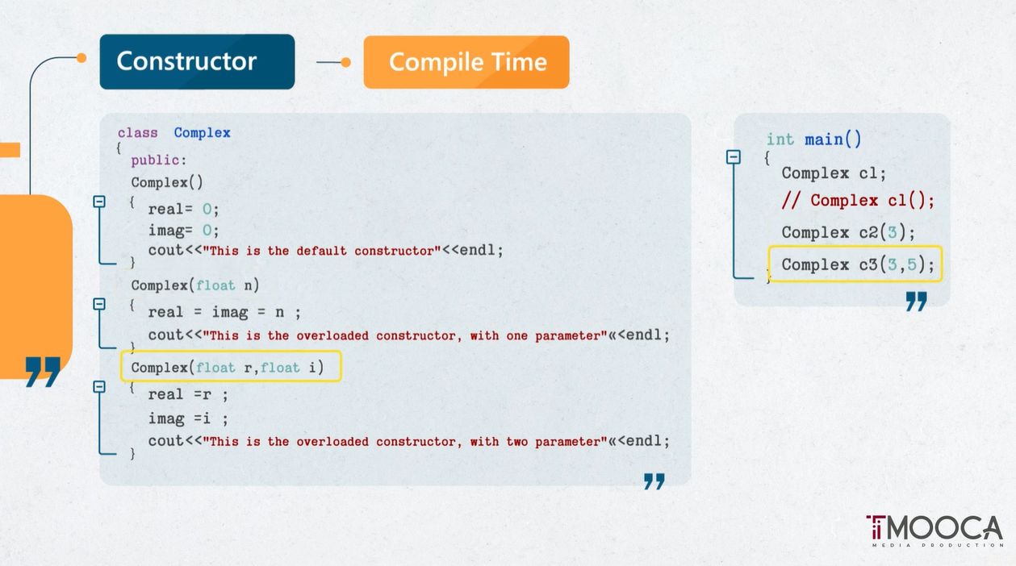

Slide 13
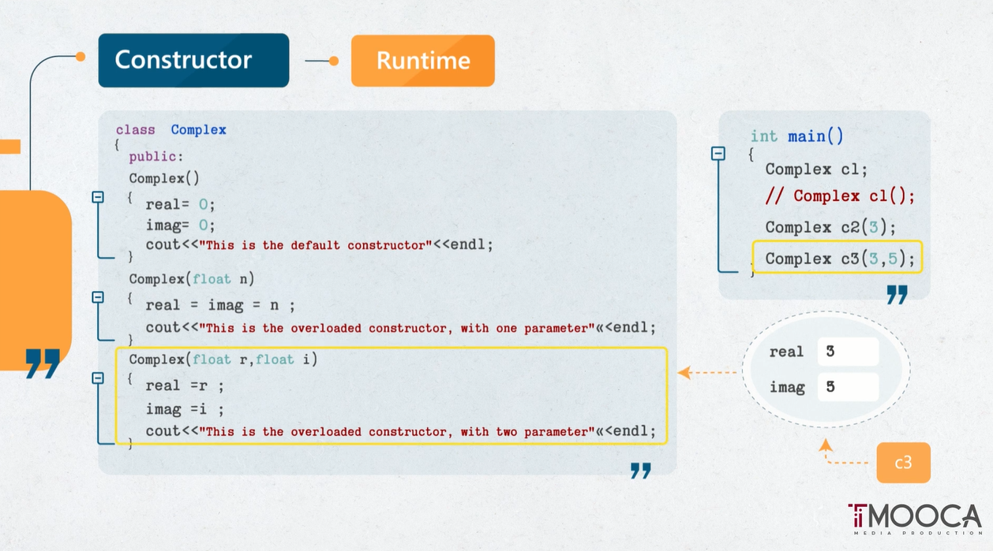

Slide 14
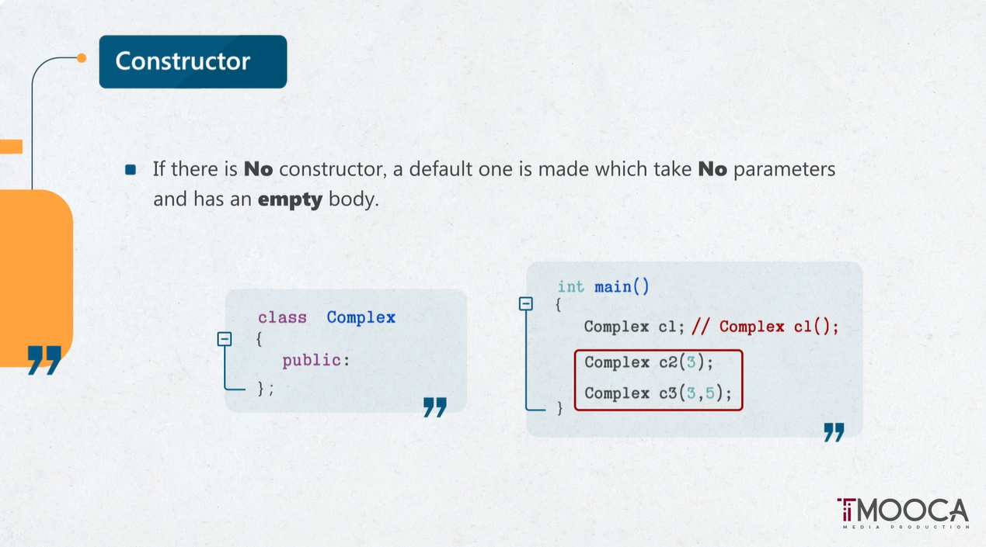

Slide 15
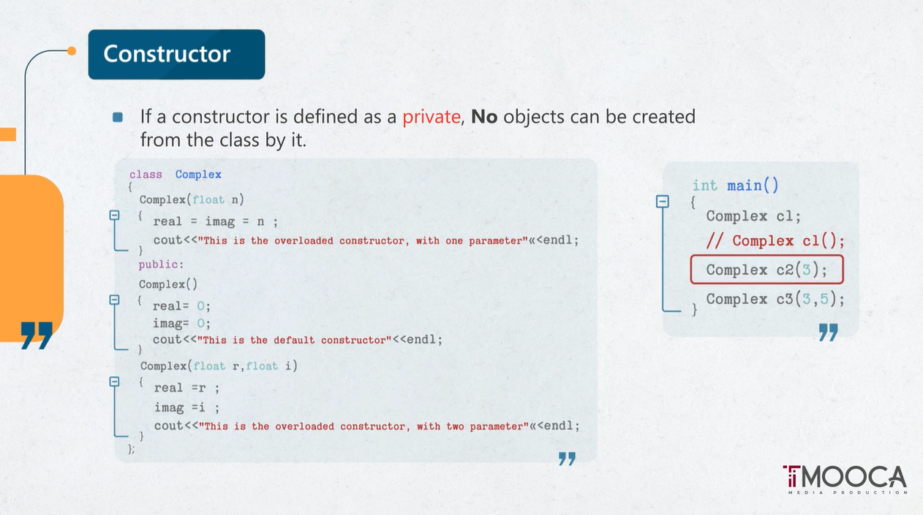

Slide 16
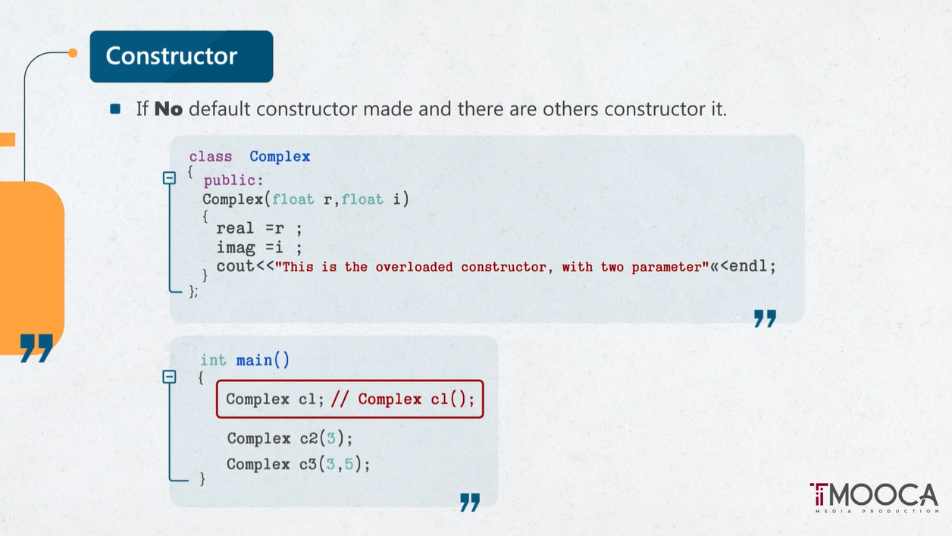

Slide 17
